Slide 1
LRS Designs: Best Practices Involving Roundabouts
Arizona Department of Transportation
Notes:
Shaun

Slide 2
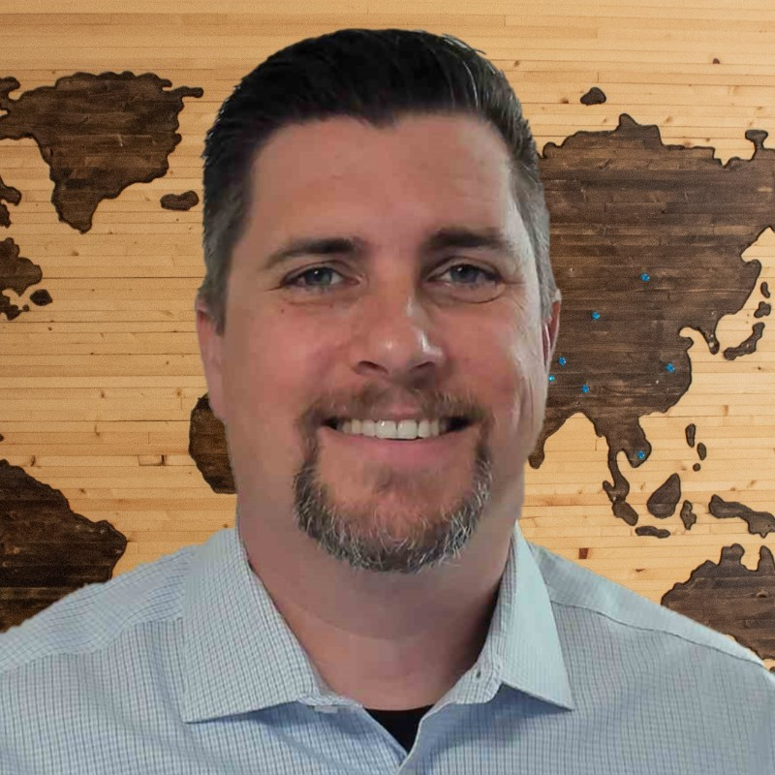
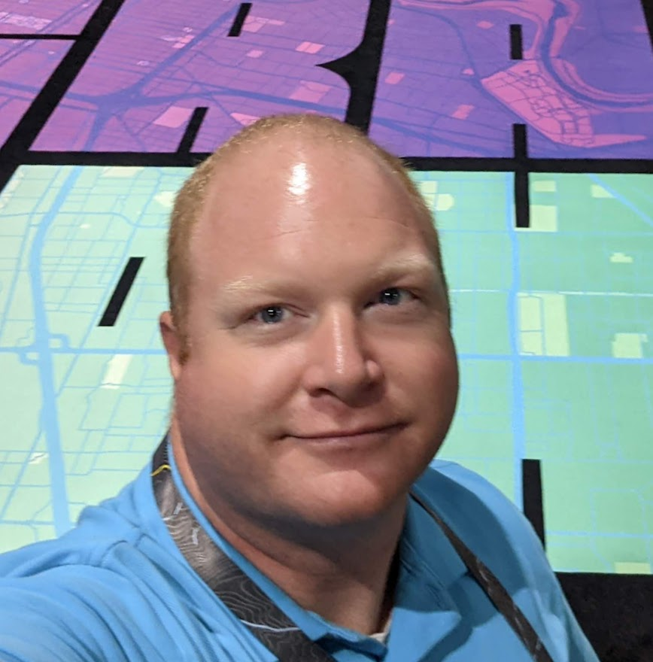
Introducing Your Presenters
Shaun Perfect
Senior GIS Analyst
ADOT
Ryan Blum
Vice President
Works Consulting
Notes:
Shaun / Joe

Slide 3
Agenda
Introductions & History
Differences in Representation & Integration
Business Needs
Design Specifications
A Work In Progress
Coordination Efforts and Sharing with Peers
Notes:
Shaun

Slide 4
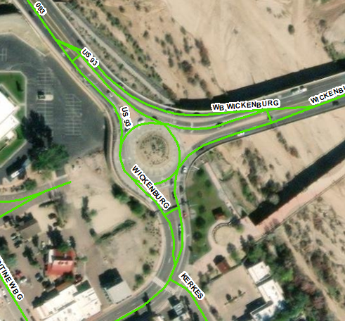
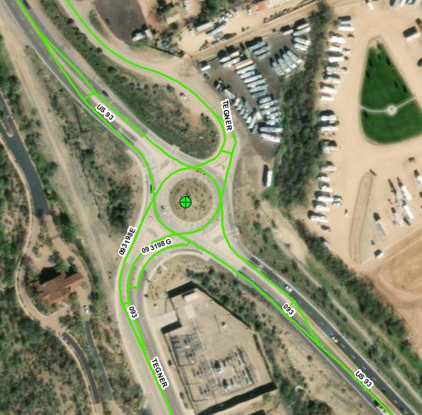
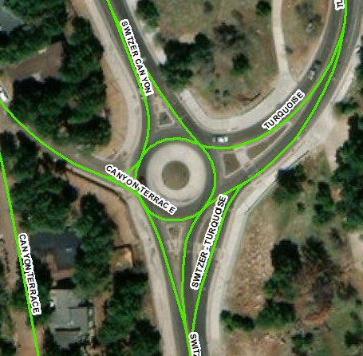
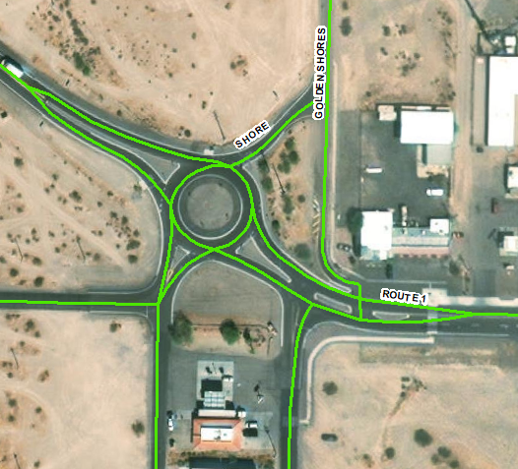
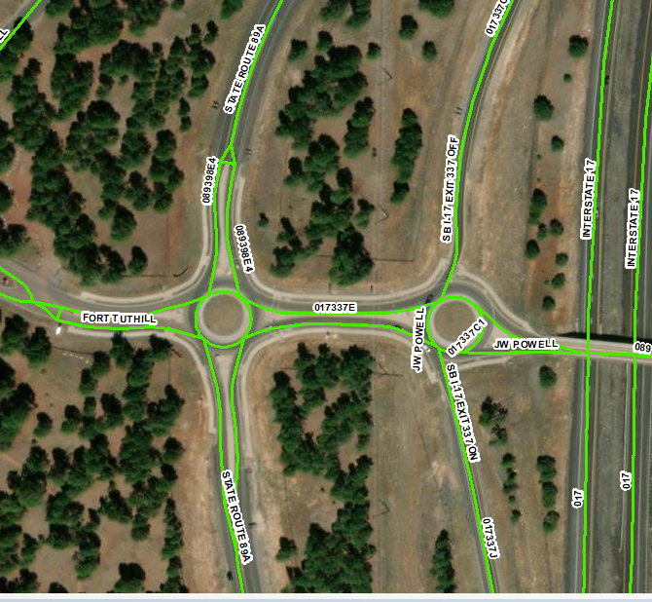
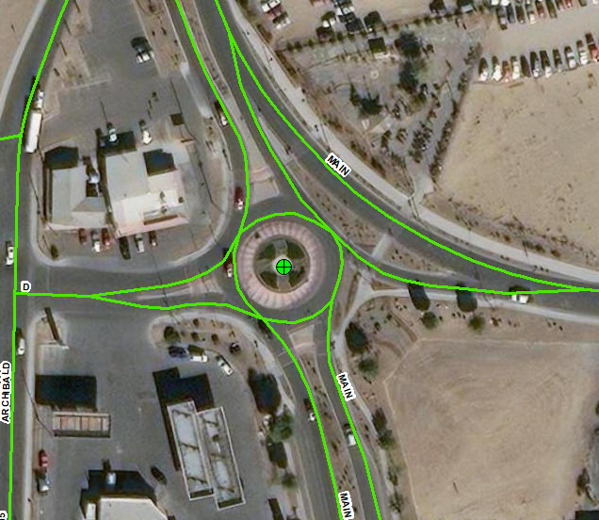
Some Roundabouts aka Traffic Circles In Arizona
Notes:
Shaun

Slide 5
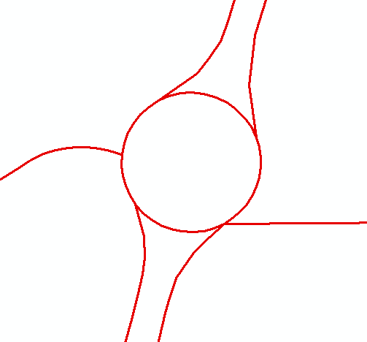
History of Roundabout LRS Representation
Roundabouts first started popping up in Arizona around 15 years ago. Since then, data collection on roundabouts have given headaches to many analysts around the State.
Shortly afterward, Arizona had an explosion of roundabout installations. Today there are over 80 or so roundabouts in ADOT’s Arizona Transportation Information System (ATIS) as well as hundreds of more local roundabouts.
The influx of roundabouts brought the need to create guidelines for LRS representation. These guidelines enhance the accuracy of data collection while still allowing for flexibility in representation (rules vs guidelines).
Notes:
Shaun

Slide 6
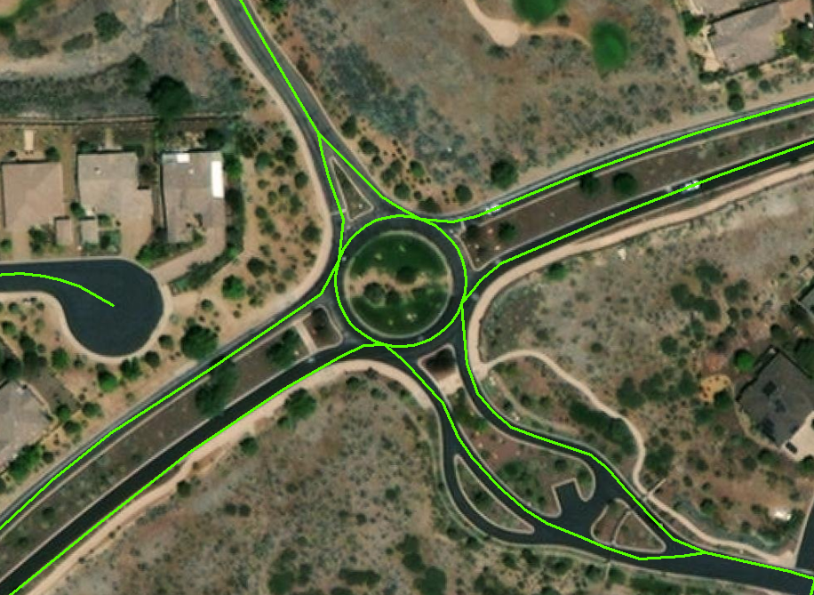
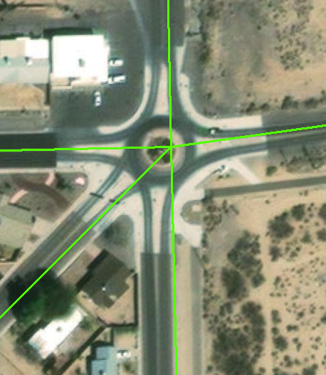
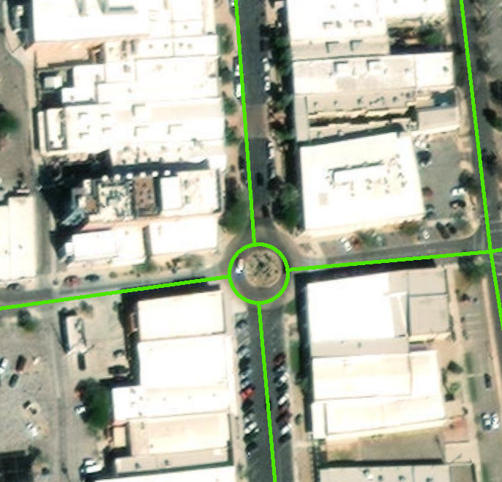
LRS Representation: Differences Between Local Suppliers
Yavapai County Graham County Yuma County
Each suppliers differences in design (at the time of reference) further emphasized the need for ATIS LRS roundabout standardization.
Notes:
Ryan

Slide 7
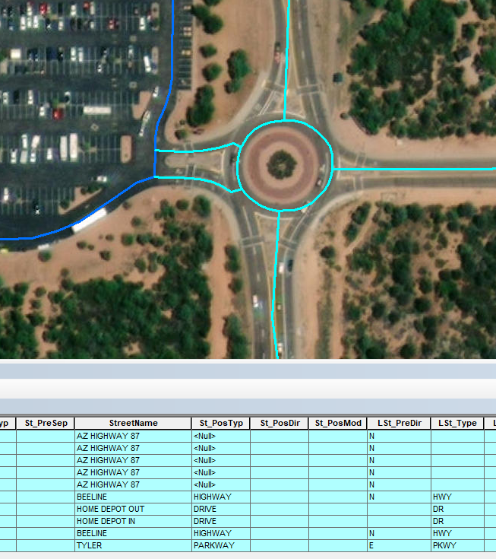
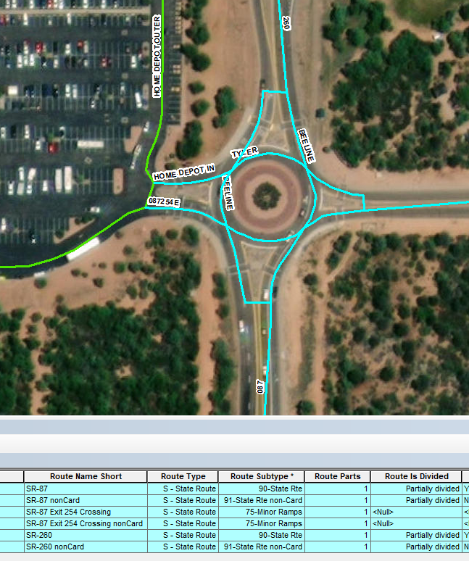
LRS Representation: Converting Local to State Design
The left image shows the unaligned local centerline before it is transitioned into the State LRS centerline.
The right image shows the State LRS representation after transition.
Local (Original Centerline)
State
Notes:
Ryan - explain “Unaligned”

Slide 8
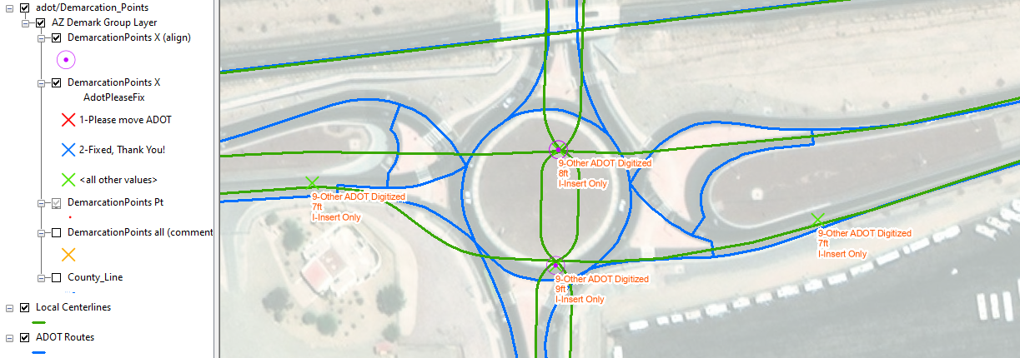
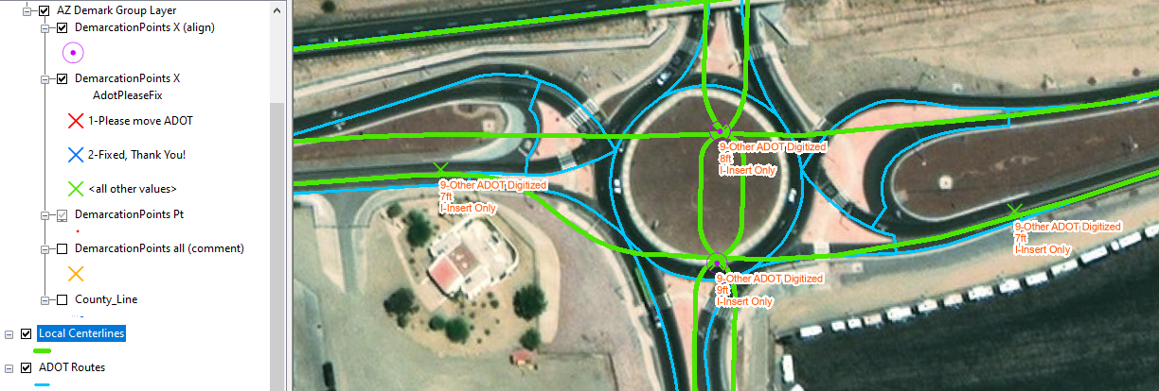
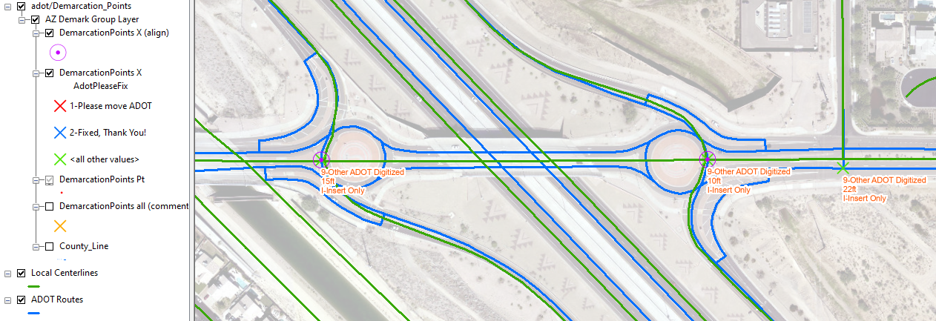
Using Demarcation Points to Align Local & State Routes
ADOT uses demarcation points to synchronize/align multiple separate roadway networks. This alignment is done with two demarcation types:
Reach demarcation points:
Enforces all routes within a specific distance pass through a common point (x,y).
Align demarcation points
Enforces spatial concurrency between two or more routes between a pair of points
Notes:
Ryan

Slide 9
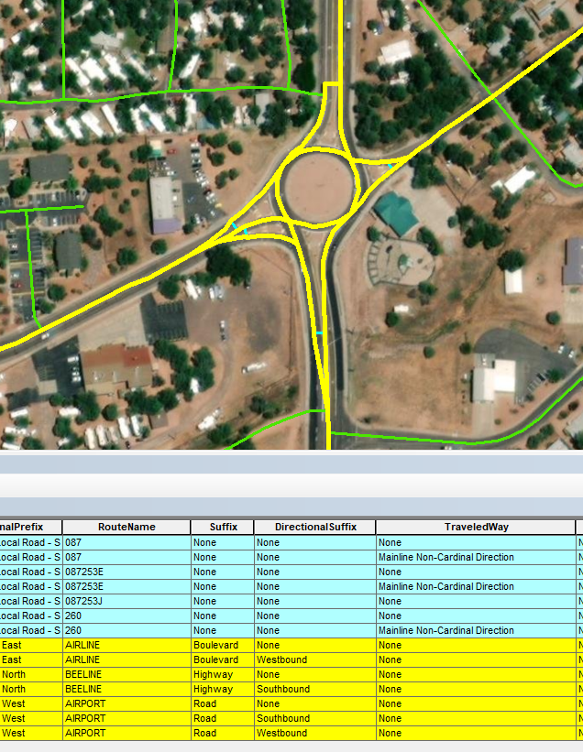
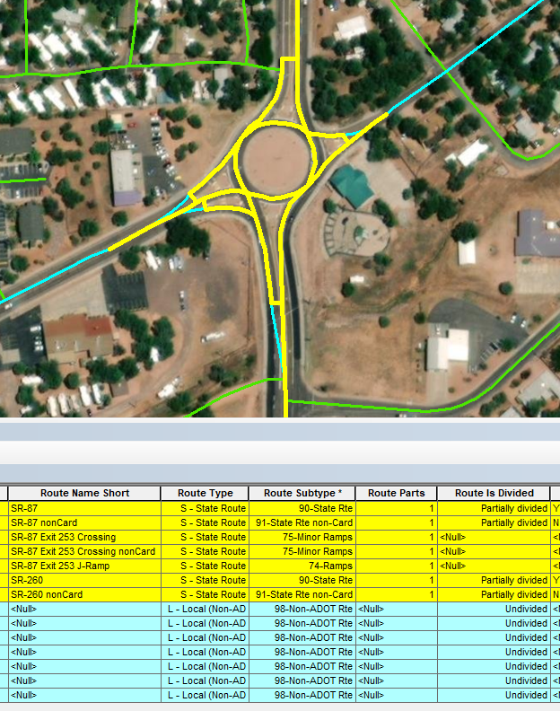
LRS Representation: Allowing for overlapping representation
ADOT allows both local and State level LRS representations in the same route network.
Most State routes have overlapping local route representations. This allows for both networks to exist within ADOT’s LRS. Local centerline representations are aligned to match the State network using demarcation points. An exception to this is perpendicular connectors used mostly on divided highways or ramps.
Local
State
Notes:
Ryan

Slide 10
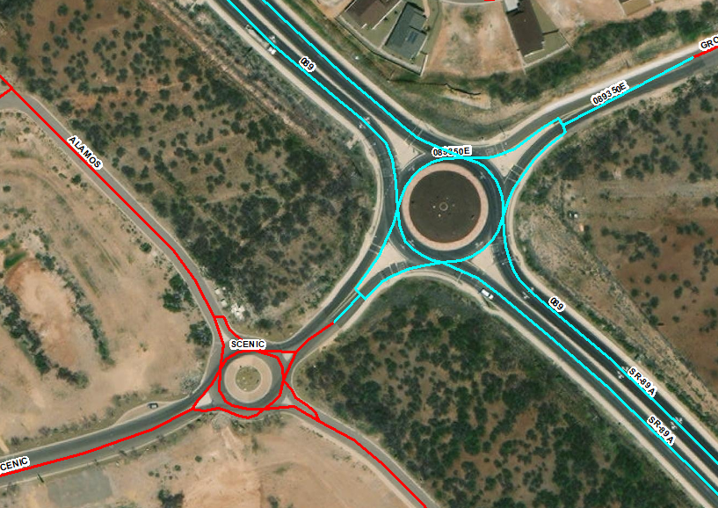
Focus on State Routes
Our priority exists for roundabouts on the State Highway system (ADOT owned routes). The hope is to be able to assist locals in implementing these roundabout designs… but it is up to each local agency do decide.
Notes:
Shaun - We do not enforce locals to envelope our LRS standards

Slide 11
Business Needs For LRS Roundabout Design
Safety
Pavement
Maintenance & Asset Inventory
Federal Reporting
Notes:
Shaun - Whole section / E-911?

Slide 12
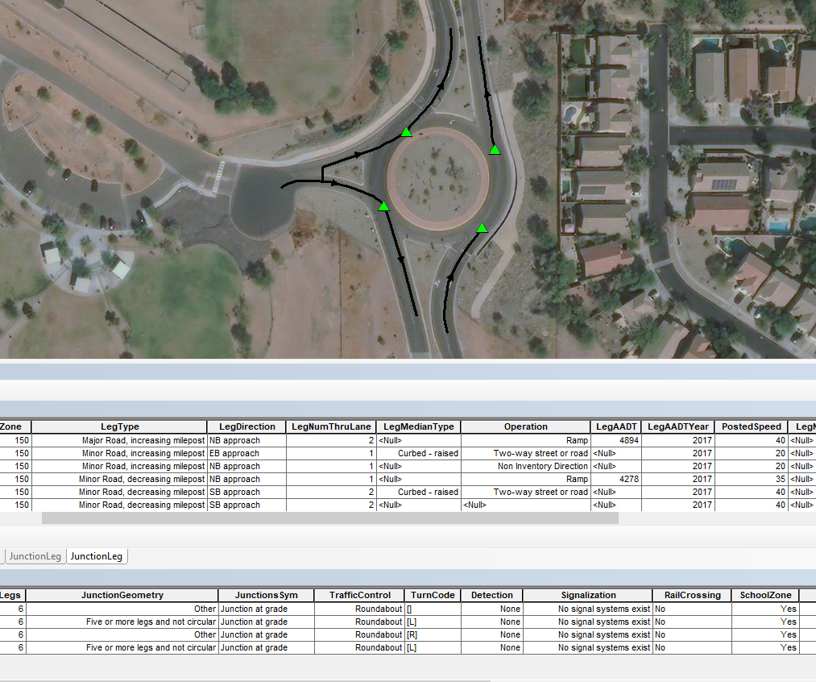
Business Needs: Safety
LRS in Roundabouts needed to support junctions and junction legs properly
This design exemplifies more accurate angles within the roundabout obtaining a precise circular conglomeration of intersecting routes.
Supports MIRE
Notes:
Shaun - MIRE rules - legs and angles

Slide 13
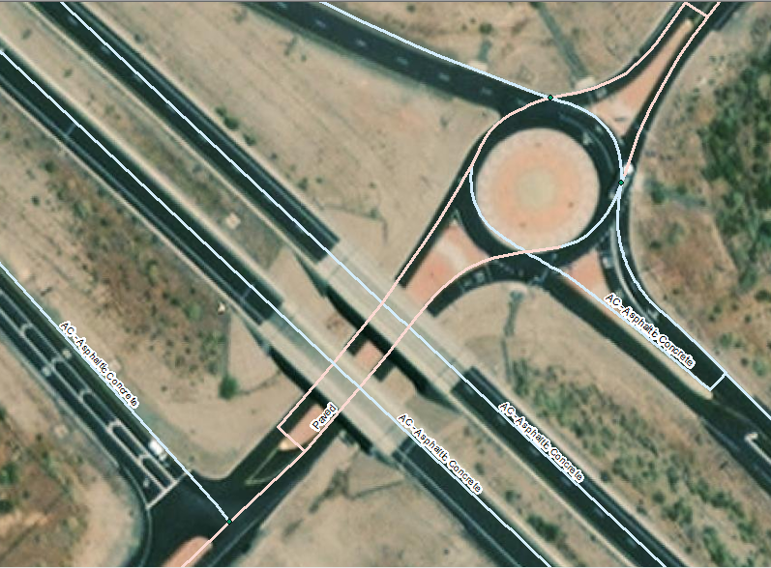
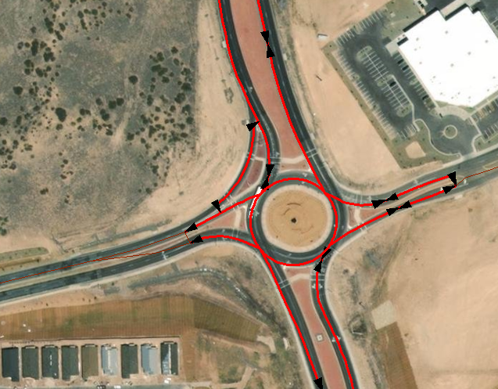
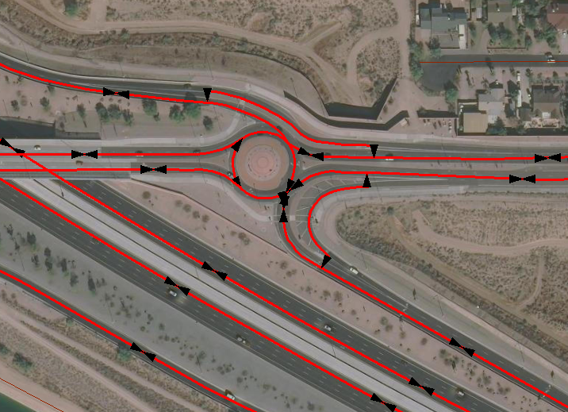
Business Needs: Pavement
LRS needed to support pavement type on all locations (bi-directional carriageway) showcasing physical ground reality of whole roundabout.
Notes:
Shaun - Picture with bins - DONE

Slide 14
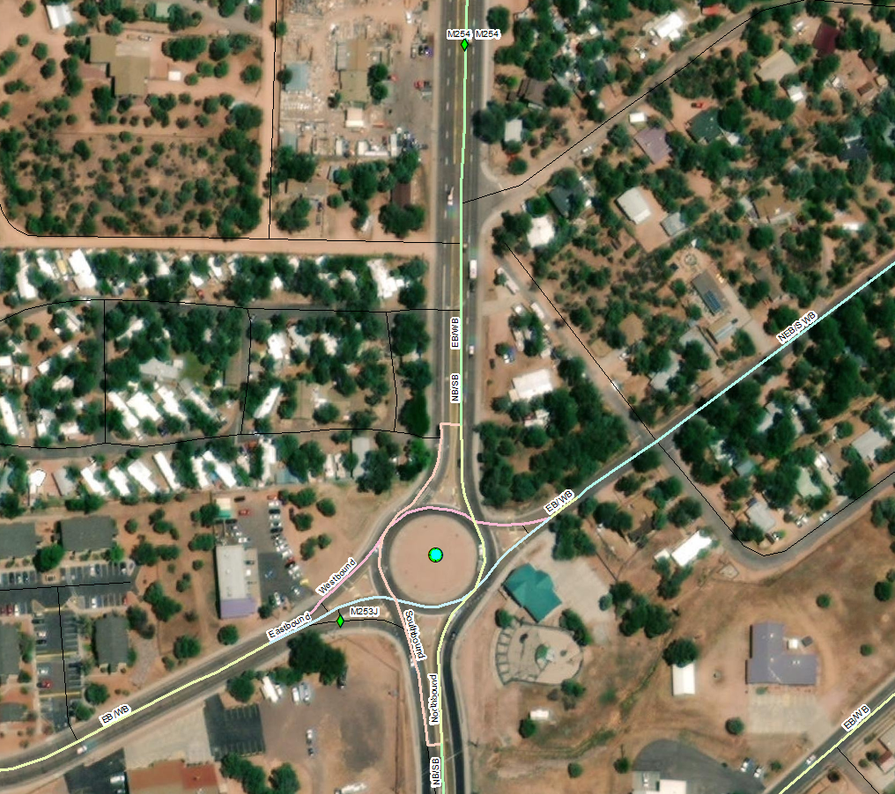
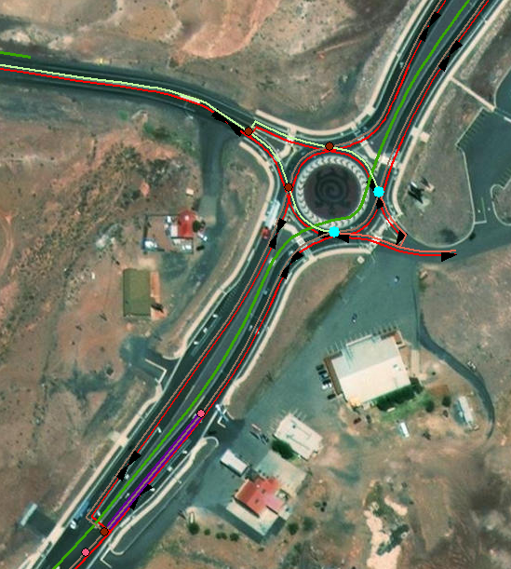
Business Needs: Maintenance & Asset Inventory
The LRS design better locates specific areas of interest (e.g. culverts) used for maintenance crews. It allows for more complexity of assets placed on specific parts of the roadway.
Notes:
Shaun - Picture with example - DONE

Slide 15
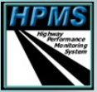
Business Needs: More Accurate Federal Reporting
Highway Performance Monitoring System (HPMS)
Accurate shapes allow for better asset collection for sampling
Model Inventory of Roadway Elements (MIRE)
True geometry allows for much more accurate crash analysis
All Road Network of Linear Referenced Data (ARNOLD)
Better planning through better design (FMIS, dual carriageway locations, etc)
Certified Public Mileage (CPM)
More realistic modeling allows for State to claim ALL roadway
Notes:
Shaun - Think of examples of data for each bullet - I filled in a few examples

Slide 16
Design Specifics For Roundabout LRS Support
Route Connectivity & Divided Highway Representation
Ramps
Local Routes
The Claw
The Round Hashtag
Notes:
Ryan - whole section

Slide 17
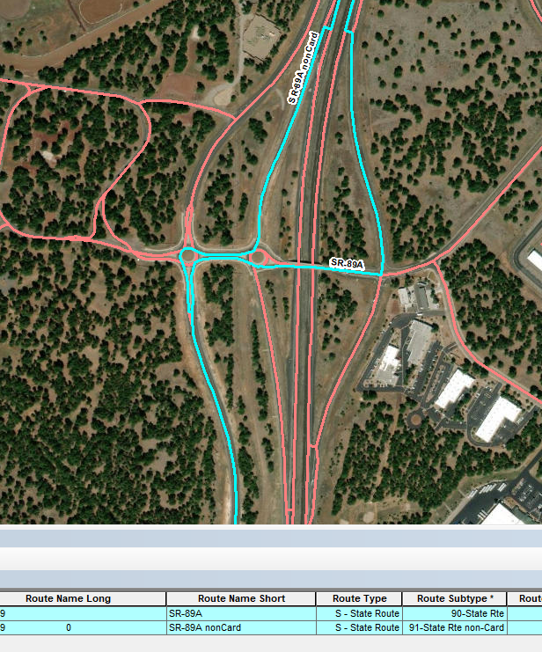
Design Specifics: Route Connectivity & Divided Hwy Representation
Route connectivity is important to our route design across the State of Arizona (not just in roundabouts) because it allows for routes to be represented along their entire length, mimicking real world sign designation.
The image to the right shows State Route 89 Alternative (both directions) highlighted in blue as it continues through two roundabouts and overlaps with Interstate 17 as continuous routes (one record for each direction).
Notes:
Ryan - Add a picture of the the signs

Slide 18
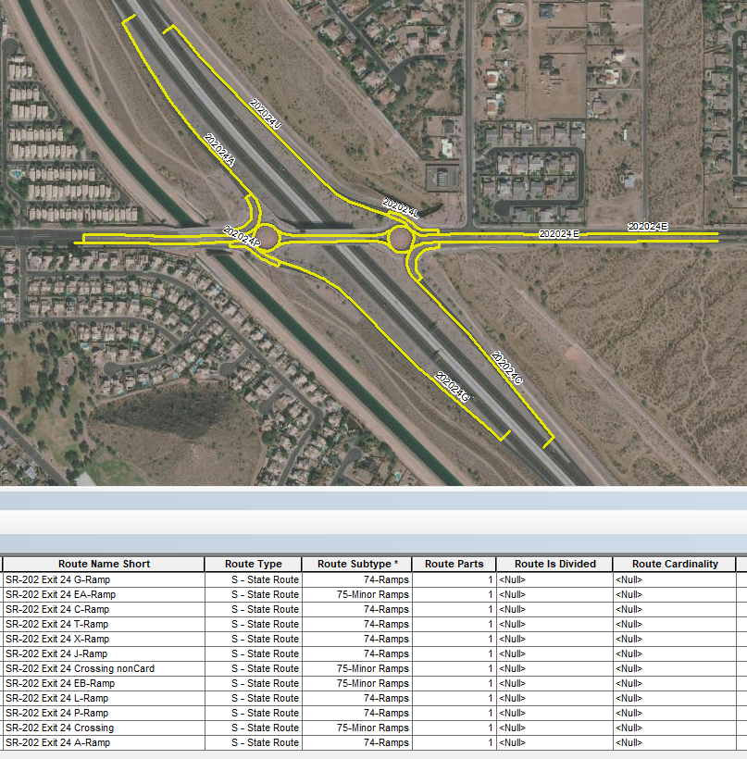
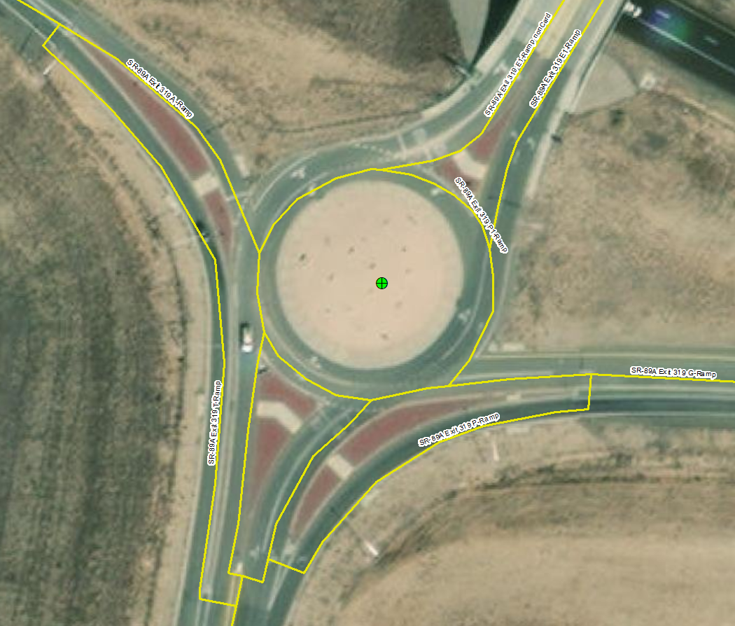
Design Specifics: Ramps
Support for all ramps turning movements from the roundabout.
Notes:
Maybe find a better picture

Slide 19
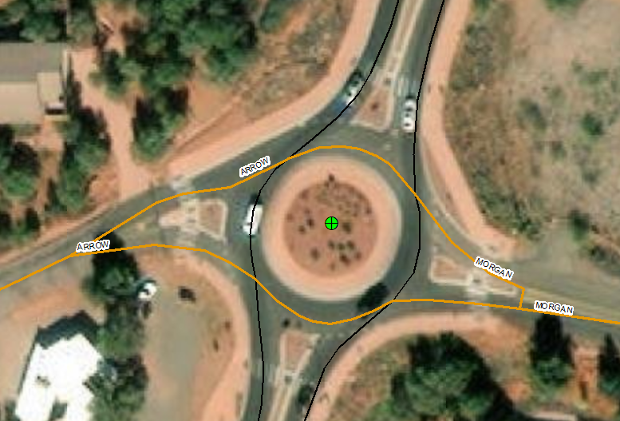
Design Specifics: Local Routes
Support for all overlapping local routes intersecting roundabouts
Notes:
maybe a better picture?

Slide 20
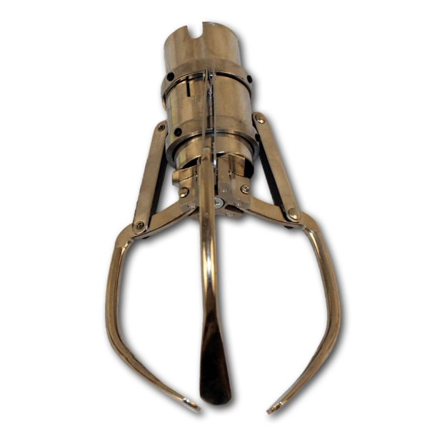
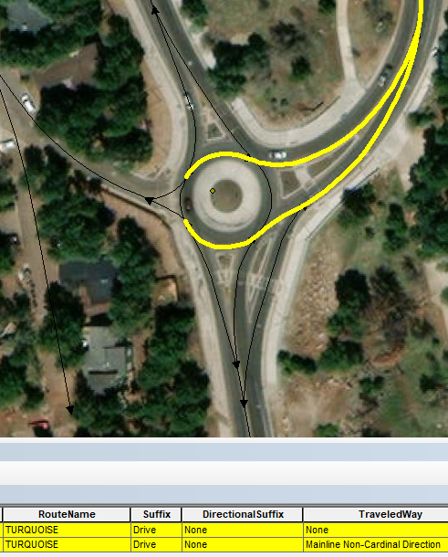
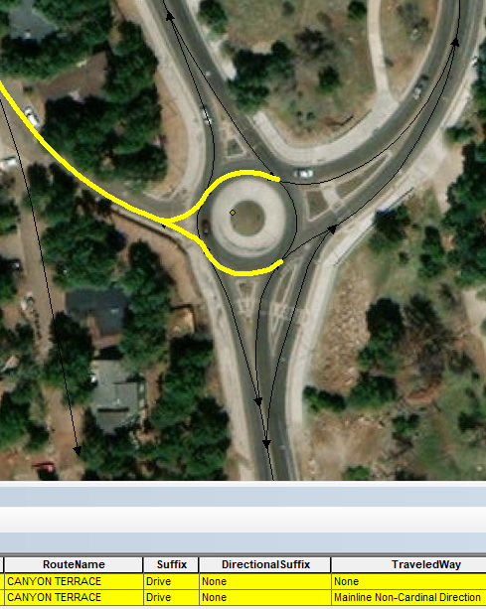
Design Specifics: The Claw
We found that it is better to design intersecting routes that support all intersecting parts of the divided Highway (even though routes overlap). This way, all road names at a roundabout are accounted for. This is valuable data for safety and MIRE.

Slide 21
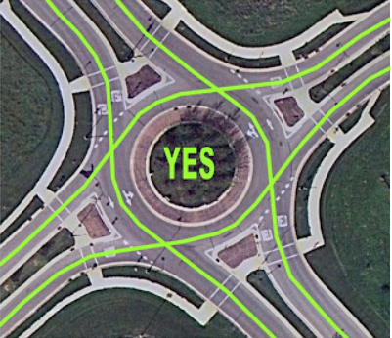
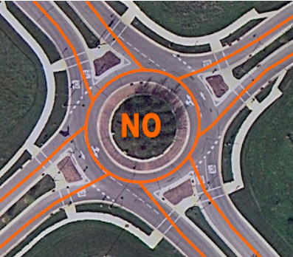
Design Specifics: The Rounded Hashtag
4 Unique (not 8) points of intersection
4 Routes create circle
Lines depict “Through movements” (Not Turning Movements) for entry and exit of roundabout
Source: https://groups.google.com/g/google-mapmaker/c/ru3jgbl0A8w?pli=1
From a certified Professional Traffic Operations Engineer that specializes in roundabout design
#
Notes:
Need to finish

Slide 22
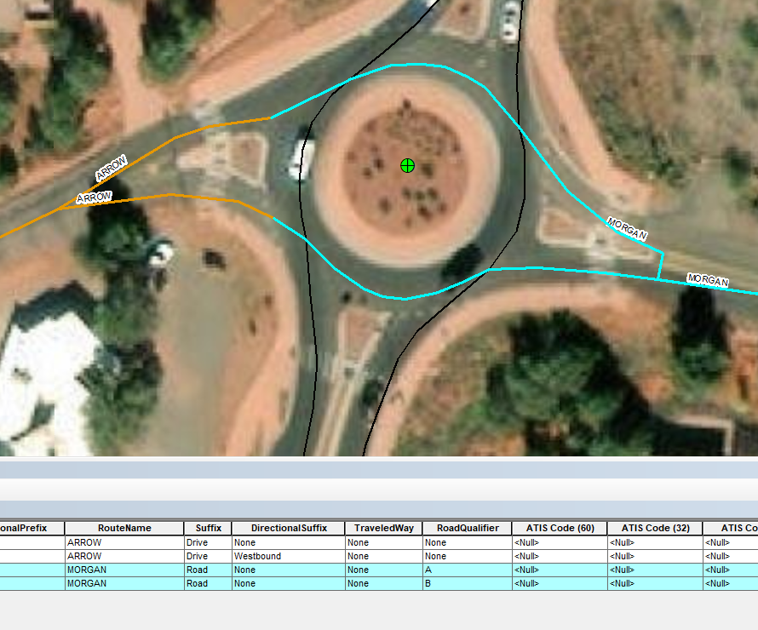
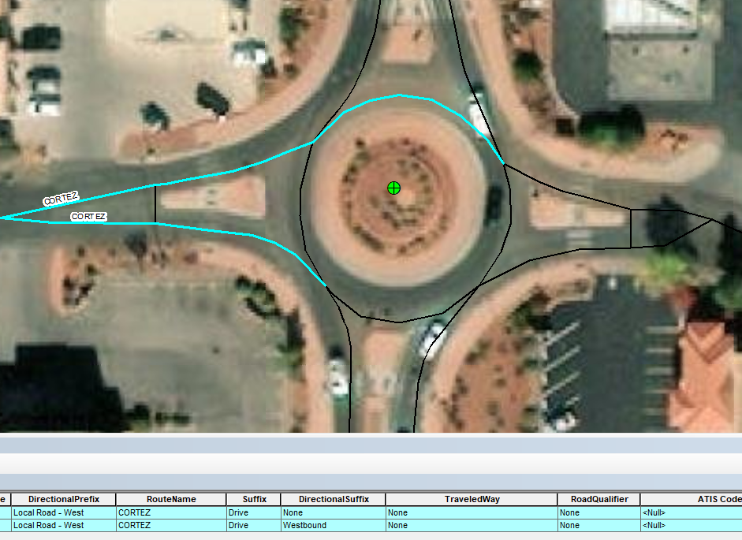
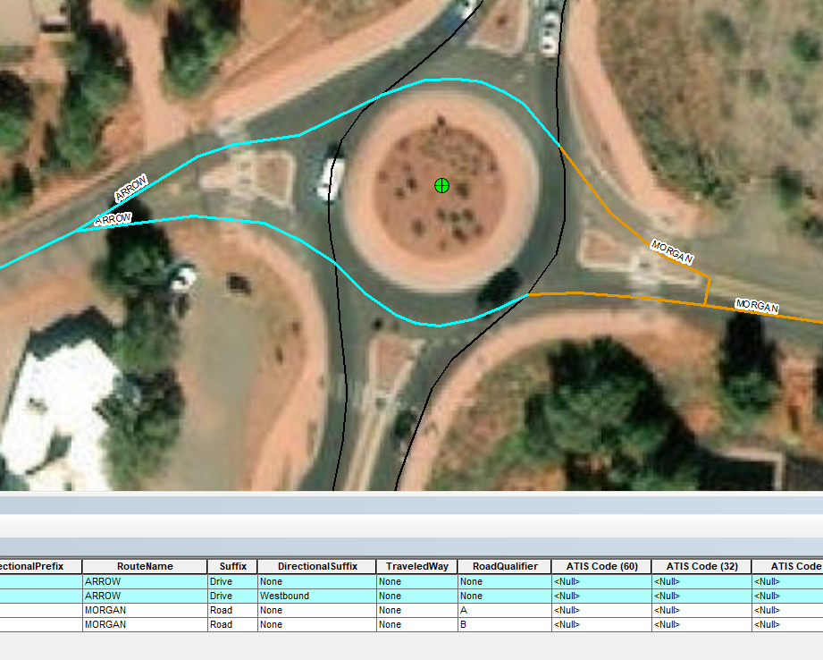
A Work in Progress
Still have roundabouts that need to be updated to new standards.
Line work still needs to be standardized for collection (1:400)
Full event data collection at roundabout locations
Notes:
Shaun

Slide 23
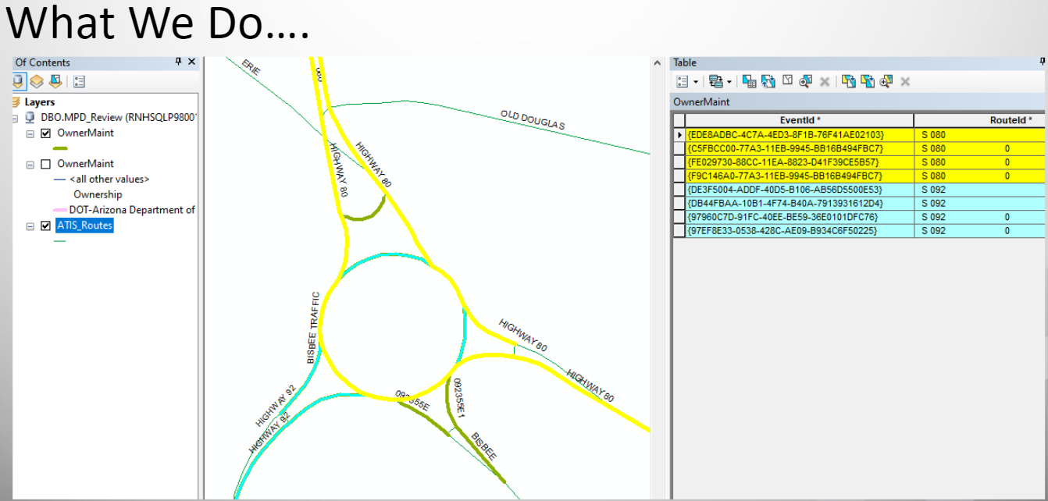
Idea Sharing and Implementation with other DOTs
We have already coordinated with other DOTs with sharing our methodology and visions. Most recently, the Tennessee Department of Transportation reached out to us inquiring about our roundabout LRS design and they have been receptive in implementing themselves.
We are always open to collaboration efforts with our peers.
Notes:
Shaun

Slide 24
Questions
Shaun Perfect
Email:
sperfect@azdot.gov
Ryan Blum
Email:
rblum@gisworks.com
Notes:
Shaun / Joe

Slide 25
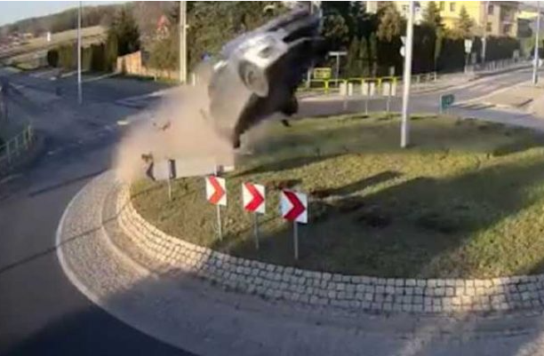
Extra: Roundabouts & Safety in Arizona Video
Here is a recent ABC news broadcast about how one local roundabout specifically is causing issues and the importance of all relating roundabout elements:
https://www.abc15.com/news/operation-safe-roads/surveillance-cameras-capture-dangerous-behavior-at-phoenix-neighborhood-roundabout
Notes:
If needed to use up time

