Slide 1
Welcome to the November 2023 meeting!
NG911 Countywide Meeting
Notes:
Explanation of slide: Introduction to the meeting
The County wants to have regular meeting to have time to discuss 911 related topics as we all move towards an November 2023 deadline. The deadline is to have the County-wide GIS data used in a Next Generation Core Services Spatial Routing. The GIS data must meet National Emergency Number Association (NENA) mandatory field values and spatially work in a vendor Next Generation Core Services system. The vendor for Arizona is ComTech911 based in Seattle Washington, whom has an office in Tempe, AZ with support from Digital Data Technologies, Inc (DDTI) out of Columbus, Ohio.

Slide 2
Agenda for today
22
Welcome, Introductions & Agenda Review
Statewide Workflow
How Local Organizations fit into NG911 Process
Progress to Improve Workflow between Agencies
Open Discussion
Discuss Future Meetings
Notes:
Explanation of slide: Outline the agenda in groups of topics.

Slide 3
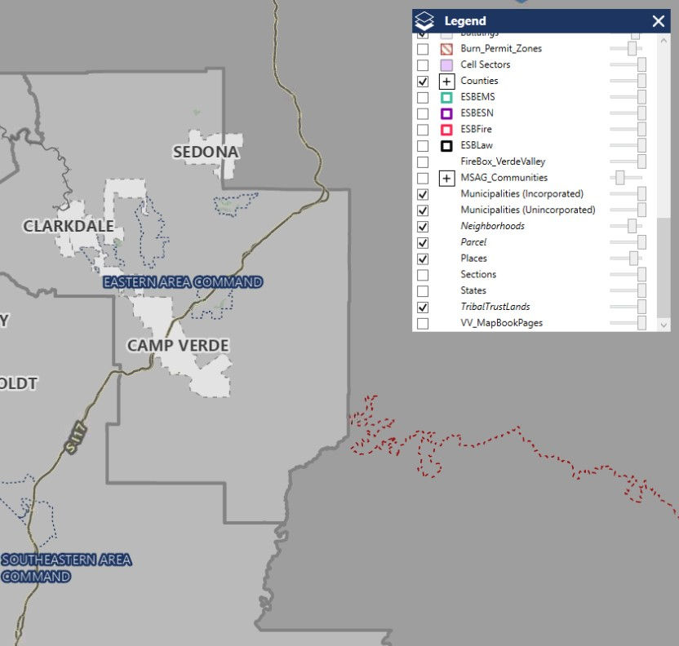
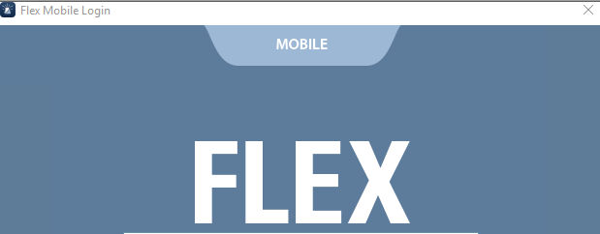
Introduction
33
Status of Current Applications - Vesta Map Local and each local Computer Aided Dispatch mapping software.
Notes:
Explanation of slide: Screenshot of Vesta Map Local. Each Agency has their own Computer Aided Dispatch which this data can be used for but the Computer Aided Dispatch may not directly be supported by the County and the county-wide GIS data.
Next Generation 911 – Public Safety Answer Points (PSAP) call-handling equipment (CHE) provided by either Solacom (Comtech) or Motorola Vesta (ATT)
Comtech ESInet/ Next Generation Core Service (NGCS) using the State-wide GIS Data.

Slide 4
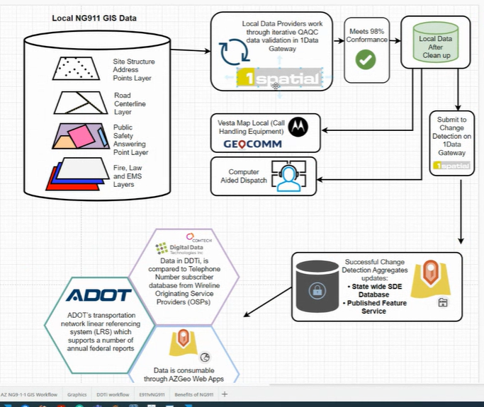
State Workflow Overview
4
Notes:
Explanation of slide: How the process to load data to 1Spatial leading into the Location Database (LDB) Manager.

Slide 5
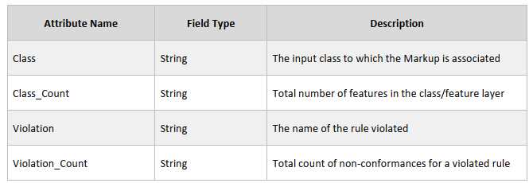
State Workflow - QAQC
5
1Spatial uses a standard output to report rule violations, also known as non-conformances. This standard output referred to as Markup, provides information that enables a user view to individual non-conforming features.
Notes:
Explanation of slide: 1Spatial is a new product that look at the GIS data for many types of attribute and spatial issues. Require attribute issues that must be resolved are any NENA GIS Data Model field that is REQUIRED. Spatial issues are not as defined what is needed but Roads and address points with each feature not being duplicated and not violating certain GIS standards must be met.
We have discussed 1Spatial 1Data Gateway in prior meetings. Everyone should be able to view the markups and certain markups must be corrected before we go live with Next Generation 911. They really need to be done now but the urgency has not been stressed enough by the county GIS department.
Essential Geometry Validations Rule Catalog - https://azgeo.maps.arcgis.com/home/item.html?id=084020b64cc04b21a437400b2649c6b2

Slide 6
State Workflow - QAQC
6
1Spatial expects a zipped File Geodatabase format.
County GIS python runs Export, Translate, Load (ETL) function of the NENA formatted Countywide GIS data
County modifies some field value by
removes all domains,
changes street fields to Title case,
converts any Blank value to NULL for this system
Notes:
Explanation of slide: Explain the county GIS department process to load data into 1Spatial.

Slide 7
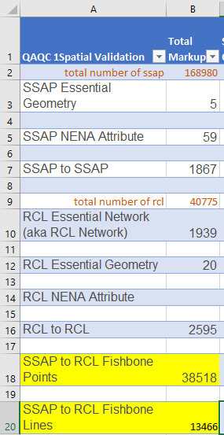
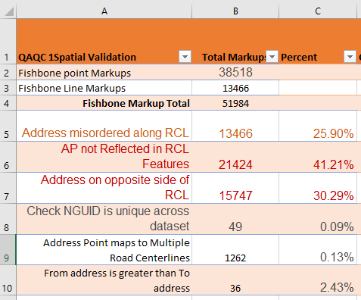
State Workflow – QAQC Violation Counts
7
https://experience.arcgis.com/experience/90bee3632024493f86202b1da6456fe4
Notes:
Explanation of slide: Violation counts of 1Spatial county-wide.
Web application to review:
https://experience.arcgis.com/experience/90bee3632024493f86202b1da6456fe4
ArcGIS Pro add web map, you can bring this web map directly into ArcGIS Pro when you are logged into your AGOL account that is a part of the Yavapai County 1Data Gateway Group:
https://yavgis.maps.arcgis.com/home/item.html?id=f758f5cf7ed54a189b2c2d266271100e

Slide 8
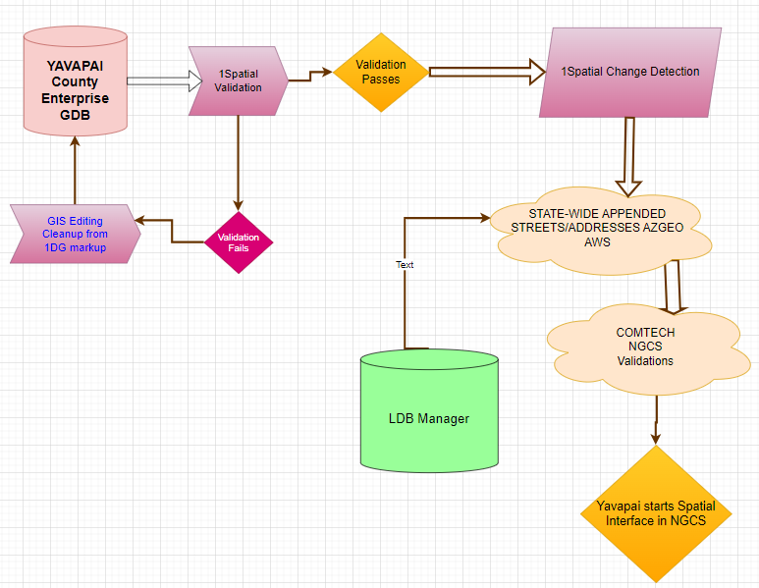
State Workflow - Change Detection
8
Notes:
Explanation of slide: How the process to load data to 1Spatial leading into the Location Database (LDB) Manager.
https://agic-public-safety-committee-agic.hub.arcgis.com/

Slide 9
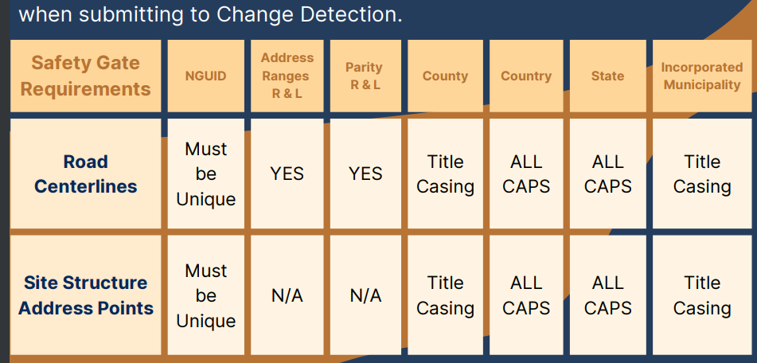
State Workflow - Change Detection
9
Change Detection requirements
Notes:
Explanation of slide: 1Spatial Change Detection Requirements for road centerlines (RCL) and site structure address points (SSAP)

Slide 10
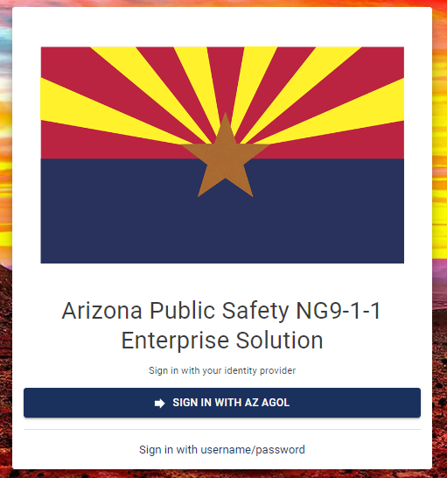
State Workflow - QAQC
10
Road segment address range assigned should be nearly the same to what is in the Master Street Address Guide (MSAG) table of Landline customers. No longer managing MSAG table through the Legacy MSAG System. Update using State-wide Road Centerlines and a process in LDB Manager to send out Open Discrepancies worksheet each week.
Notes:
Explanation of slide: Introduction to the Location Database Manager (LDB manager) Relates to the State-wide address and state-wide Road Centerlines.
The County-wide GIS streets and Address Points are used in this geocoding process. Each year we have sent out records that failed to match the GIS but we have never been real clear or forceful in requesting GIS corrections done. This will change with t new workflow discussed later.

Slide 11
Location Database (LDB) Manager Workflow
The LDB workflow replaced the quarterly Telephone Number Accuracy Report process.
The Location Database (LDB) is where the State houses Automatic Location Information (ALI) data for the Next Generation (NG911) transition.
LDB Manager is an application where we search, access, and help resolve discrepancies.
Discrepancies affect call routing for emergency services.
Notes:
•The Location Database Manager workflow came from the State to help validate our data for the purposes of call routing in the NG911 system.
Instead of the quarterly TN Accuracy Report, we receive a weekly Excel spreadsheet of discrepancies, cleaning up errors continually.
•During and after Arizona’s transition to NG911, Automatic Location Information (ALI) is stored in the LDB.
•LDB Manager is how we resolve these by either requesting a translation or assigning to another agency or party to fix.
•Why is this significant? The errors from weekly reports can potentially affect call routing for EMS.

Slide 12
Location Validation Function (LVF) Discrepancy Workflow
2023 Yavapai County NG911 Meeting
Notes:
•Workflow from State documentation
Service Order Input (SOI) files are processed into the NG911 system, and validated against GIS data, also called GIS Master Street Address Guide (MSAG) data.
•Invalid records are rejected and reported back to the Service Provider
•Valid records are accepted into the LDB, and address and road centerlines are validated using the Location Validation Function (LVF).
•If a record isn’t validated, a discrepancy is created.
•Discrepancies are reported to the GIS provider to review and correct, if necessary. If corrected, it isn’t reported in the next weekly email list of discrepancies.
•The GIS provider can also work with Digital Data Technologies Inc (DDTi), a sub-vendor of Comtech, to apply a translation to fix the error.

Slide 13
Types of Discrepancies In LDB Manager
•Critical:
The service provider falls outside of the provisioning boundary.
No mapping or call routing is returned.
•High:
No match between either road centerline or address point.
A default routing will be used to route the call.
•Moderate:
The ALI record name matches a road centerline but not an address point.
The house number is not included in centerline address range.
Multiple mappings may be used to route the call.
•Low:
The ALI record name matches a road centerline but not an address point.
Errors with sub-addressing fields.
Single call routing is returned.
2023 Yavapai County NG911 Meeting
Notes:
•Four main types of discrepancies are created from the LVF process, in order of severity regarding routing 911 calls correctly.
•Critical: System is unable to locate the address; no default mapping in place, and needs to be corrected immediately. Typically a server error.
•High: No match between road centerline or address point in ALI record and GIS data. Default mapping used.
•Moderate: The location data in the ALI record matches to a road centerline but not an address point. Typically, the address range doesn’t include the house number. Multiple mappings returned; one is randomly selected, which may be incorrect.
•Low: Matches to road centerline but not address point. Address range covers the house number but other fields are invalid (sub-addressing). Single mapping returned with errors.

Slide 14
How are discrepancies resolved In LDB Manager?
•GIS Update: Update the GIS data with the correct attribution.
•Assign discrepancy to appropriate entity: (Service Provider, neighboring County GIS, etc.) This happens in the LDB Manager!
•Request a translation: Indicate that a translation is needed to align the GIS and ALI datasets. This also happens in the LDB Manager!
2023 Yavapai County NG911 Meeting
Notes:
•Discrepancies can be resolved in 3 ways:
•GIS update: Make corrections to the data, if needed, and the errors won’t be on the next report.
•Assign in to someone else: Sometimes the service provider still needs to correct the record, and sometimes it’s not our County’s data. We can search for and assign discrepancies to other agencies/people and comment in the LDB Manager.
•Translations: As a last resort, we work with DDTi (in the LDB manager) to apply a translation to ensure the call is routed correctly.

Slide 15
How will Cities be involved In LDB Manager?
•Cities are not assigned discrepancies within the LDB Manager.
•We will email municipalities as needed to help resolve issues in order of severity (High, Moderate, and Low).
•Questions?
2023 Yavapai County NG911 Meeting
Notes:
•Cities won’t need to work within the LDB Manager directly; but will instead communicate with us to provide needed corrections that will be included in the city updates we receive.
•We will be reaching out to you to help resolve discrepancies in order of priority (High, Moderate, Low).
•Questions?

Slide 16
State Workflow
References: https://agic-public-safety-committee-agic.hub.arcgis.com/pages/ng911
16
Next Generation Core Services
ComTech / DDTI
Invalid geometry
Gap/overlap
Duplicate attribute as defined by the SI system
Mandatory field(s) missing or mismatched data types
Address range issues on centerline
General provisioning failure to SI or ECRF/LVF
Malformed Uniform Resource Identifier (URI)
2023 Yavapai County NG911 Meeting
Notes:
Explanation of slide: 1Spatial Validations have been preparing us for similar rules to be tested against GIS data to be loaded into ComTech’s Next Generation Core Services, the Spatial Interface.
Emergency Services IP network (ESInet), Next Generation Core Services (NGCS), and call-handling equipment (CHE) » ESInet is the network » NGCS is comprised of functional elements that use standard interconnections to work with any provider anywhere » i3-capable CHE allows PSAPs the full capabilities of NG9-1-1
NG9-1-1 uses next generation protocols, including Session Initiation Protocol (SIP), Location to Service Translation (LoST), and HTTP² Enabled Location Delivery (HELD) over Transport Layer Security (TLS
The SI provides an interface between an authoritative copy of GIS data and Functional Elements within the ESInet.
Invalid geometry
Gap/overlap
Duplicate attribute as defined by the SI system
Mandatory field(s) missing or mismatched data types
Address range issues on centerline
General provisioning failure to SI or ECRF/LVF
Malformed Uniform Resource Identifier (URI)
NG9-1-1 deployments do not necessarily upgrade the CAD or Radio systems
AZ NG911 Project Overview - August 2022.pdf (az911.gov)

Slide 17
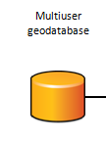
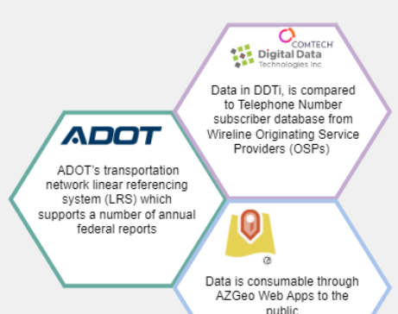
How Local and County Data Gets Into State-wide
17
GIS Feature Classes & NG911 Master Tables
CAD Map / Vesta Map Local
Notes:
Explanation of slide: Overview of the County process and a reminder about the NG911 Master Tables that will be put into production in the near future.

Slide 18
State Workflow
18
NG9-1-1 Address Management Solution
Documentation Link –
https://agic-public-safety-committee-agic.hub.arcgis.com/pages/address-management-solution https://experience.arcgis.com/experience/eb201d6fb83245e392f4555b24aec69e
Download the ArcGIS Pro solution.
https://azgeo.maps.arcgis.com/home/item.html?id=8564e064e88648b49dc02d5845f11883
Key Features:
Address Points: Easily create new address points with attribute rules that automate the generation of related attributes for comprehensive data.
Road Centerlines: Benefit from attribute rules that streamline data editing, simplifying the process of splitting and recalculating address ranges for accurate data maintenance.
NG911 Ready: Align your data with the NENA GIS Data Model and National standards, ensuring compatibility and efficient integration with Next Generation 9-1-1 services.
User-Friendly: The template comes with targeted training modules, guiding users through introductory, advanced, and master levels to master ArcGIS Pro's powerful address management capabilities.
Statewide Dataset: Leverage our comprehensive state-wide datasets, custom domains, and dynamic labels, tailored to cater to Arizona's geographic requirements.
Notes:
Explanation of slide: Address Management Solution - an ArcGIS Pro Desktop Application Template designed to create and manage address points and road centerlines, ensuring data accuracy and completeness for NG911.
Documentation Link –
https://agic-public-safety-committee-agic.hub.arcgis.com/pages/address-management-solution
https://experience.arcgis.com/experience/eb201d6fb83245e392f4555b24aec69e
Download the ArcGIS Pro solution.
https://azgeo.maps.arcgis.com/home/item.html?id=8564e064e88648b49dc02d5845f11883

Slide 19
How Local Organizations fit into NG911 Process
19
Notes:
Explanation of slide: Open Discussion about Local Workflow or a review of was presented in May 2023

Slide 20
Progress to Improve Workflow between Agencies
20
Notes:
Explanation of slide: Open Discussion about Local Workflow or a review of was presented in May 2023

Slide 21
Feedback
Sending markups VIA AGOL
Emails from LDB Manager Discrepancies
Sharing AGOL GIS Data
References - YC AGOL application:​
https://experience.arcgis.com/experience/90bee3632024493f86202b1da6456fe4​
YC GIS Countywide Meetings Summary:​
https://experience.arcgis.com/experience/fbe3015749da4b12a50c3eaee083d669​
Notes:
Explanation of slide: Getting feedback on what has been presented here.
YC AGOL application:
https://experience.arcgis.com/experience/90bee3632024493f86202b1da6456fe4
YC GIS Countywide Meetings Summary:
https://experience.arcgis.com/experience/fbe3015749da4b12a50c3eaee083d669

Slide 22
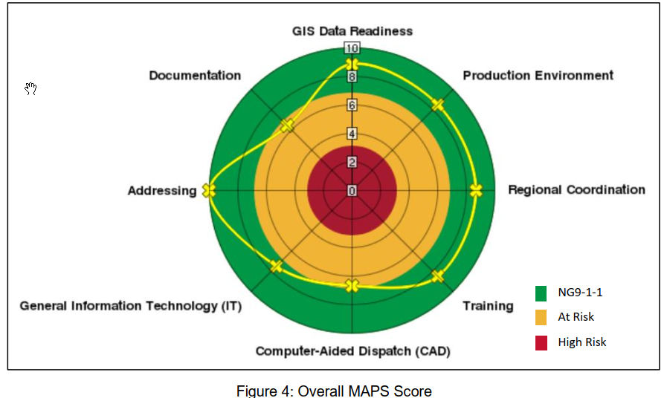
Wrap-up - Next meeting
22
Why we meet to fulfill 2021 Gap Analysis
Next meeting
Notes:
Explanation of slide:

